Slide 1
Digital Portfolio
STUDENT NAME:S.KALAIMANI
REGISTER NO AND NMID: asbru4k2422k1252
DEPARTMENT: BSC(cs)
COLLEGE: Maharani arts and science womens college/Bharathiyar university

Slide 2
PROJECT TITLE
STUDENT DIGITAL PORTFOLIO
VIDEO EDITOR

Slide 3


AGENDA
Problem Statement
Project Overview
End Users
Tools and Technologies
Portfolio design and Layout
Features and Functionality
Results and Screenshots
Conclusion
Github Link
3/21/2024 Annual Review

Slide 4

PROBLEM STATEMENT
In today’s digital era, video content is one of the most powerful tools for communication, marketing, and entertainment. However, many video editors struggle to showcase their work in a professional and engaging way. Traditional resumes or text-based portfolios fail to highlight the creative impact of video projects.

Slide 5

PROJECT OVERVIEW
The Video Editor Portfolio Website is a personal branding platform designed and developed using HTML, CSS, and JavaScript. The project aims to create a professional and visually appealing portfolio that allows a video editor to showcase their skills, projects, and contact information in an interactive way.
Header & Navigation – For quick access to all sections
About Section – Displays the editor’s profile photo, bio, and expertise.
Video Gallery (Projects Section) – A responsive grid showcasing sample video projects with playback controls
Contact Section – A form that allows users to send messages easily.
Footer – Displays copyright and optional social media links.

Slide 6

WHO ARE THE END USERS?
Potential ClientsBrands, companies, or individuals looking for a video editor for advertisements, social media content, weddings, documentaries, etc.
Recruiters / EmployersMedia companies, film studios, or agencies that want to hire a skilled video editor.
CollaboratorsOther creative professionals (directors, photographers, designers, musicians) who may want to collaborate on projects.
General Audience / FansPeople who admire the editor’s work and follow their creative journey.
The Video Editor (Owner) themselves

Slide 7

TOOLS AND TECHNIQUES
HTML (HyperText Markup Language)Used to structure the content of the portfolio.Added sections like About, Video Gallery, and Contact Form.
CSS (Cascading Style Sheets)Used to style the portfolio website.Applied responsive layouts, colors, fonts, and animations.Styled the profile photo as a circle with borders.
JavaScript (JS)Used for interactivity and dynamic behavior.Example: Handling the contact form submission with an alert.Can also be used for gallery sliders, popups, or filtering videos.
Text Editor / IDETools like VS Code, Sublime Text, or Notepad++ for coding.
Browser (Chrome/Edge/Firefox)Used for testing and running the portfolio.

Slide 8
POTFOLIO DESIGN AND LAYOUT
Overall Design
The portfolio is designed as a single-page website with smooth navigation and a clean, professional look.Dark theme with a highlight color (orange/red) for an elegant cinematic feel.Responsive design so it looks good on mobile, tablet, and desktop.Focus on showcasing videos and personal branding (profile photo + about section).
2. Layout Structure.
Header SectionContains the portfolio title / name of the video editor.A navigation menu with links to different sections: About, Projects, Contact
About SectionIncludes a profile photo displayed in a circular frame.A short bio/description highlighting editing skills and expertise.
Video Gallery (Projects Section)A grid layout that displays multiple video projects.Each video is embedded using the <video> tag with play controls.Designed with responsive grid so videos adjust to screen size
Contact SectionA contact form where users can enter Name, Email, and Message.Styled with rounded input fields and a submit button.JavaScript handles form submission (alert + reset)
Footer SectionDisplays copyright © info.Can include links to social media accounts (YouTube, Instagram, LinkedIn).
8

Slide 9
FEATURES AND FUNCTIONALITY
✨ Features
Responsive DesignWorks smoothly on desktop, tablet, and mobile devices.Uses CSS Flexbox and Grid for adaptive layouts.
Profile ShowcaseDisplays the video editor’s profile photo, name, and bio.Highlights key skills and expertise in video editing.
Video GalleryEmbedded videos using the <video> tag.Users can play, pause, and control videos directly on the page.Grid layout for showcasing multiple projects.
Interactive Contact FormFields for Name, Email, and Message.JavaScript handles submission with confirmation (alert + reset).
Navigation BarEasy-to-use header menu for smooth scrolling to sections (About, Projects, Contact).
Modern StylingDark theme with accent colors for a cinematic look.Profile photo styled as a circular image with borders.Hover effects for buttons and links.
Single Page PortfolioAll sections (About, Projects, Contact) are on a single page for easy access.

Slide 10
⚙️ Functionality
Navigation FunctionalityClicking on navigation items scrolls the page to the respective section.
Video FunctionalityVideos are playable in-browser with controls (play, pause, volume, fullscreen).
Contact Form FunctionalityUsers can enter their details and send a message.JavaScript shows a success message and clears the form after submission.
Responsive FunctionalityLayout automatically adjusts to different screen sizes.Videos resize within the grid for small or large displays.
User InteractionButtons change color on hover for better user experience.Smooth scrolling and section highlighting improve navigation.

Slide 11
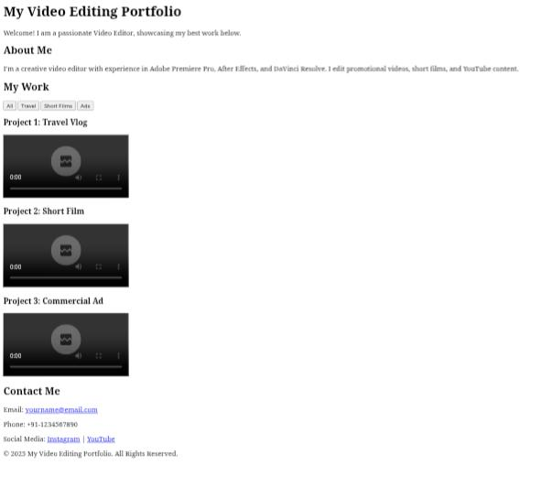
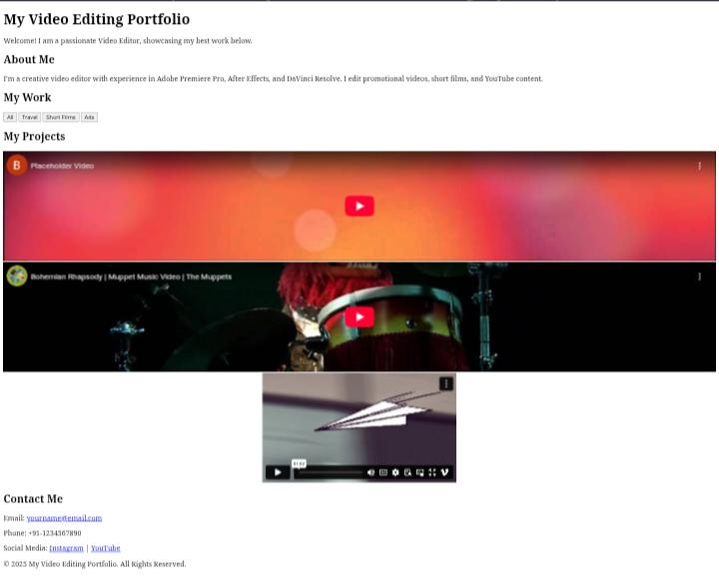

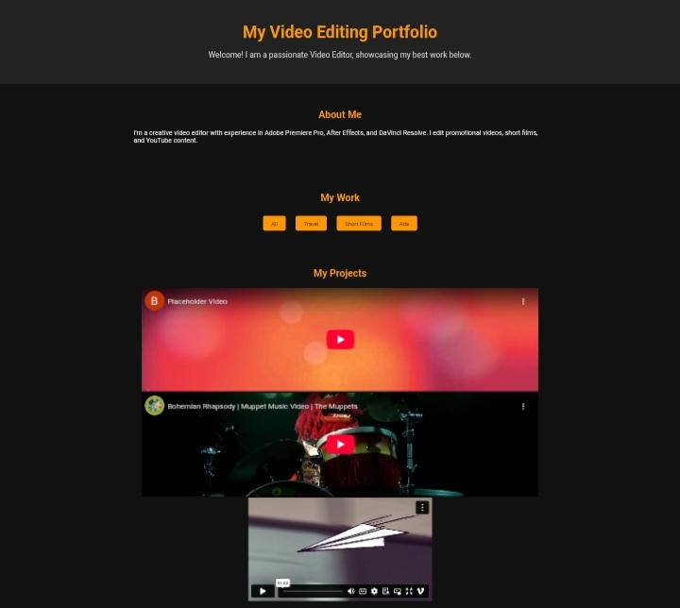
RESULTS AND SCREENSHOTS
3/21/2024 Annual Review
11

Slide 12
CONCLUSION
The design emphasizes a clean layout, responsive structure, and modern styling, making it accessible on different devices. By integrating features like profile photo display, embedded videos, and an interactive form, the project demonstrates how web technologies can be effectively applied to personal branding and professional promotion.
In conclusion, this project not only enhances the online presence of a video editor but also provides a foundation that can be expanded with additional features such as a blog section, portfolio filtering, or integration with social media platforms. It proves to be a practical solution for creative professionals to establish a strong digital identity in the competitive media industry.
12

